Slide 1
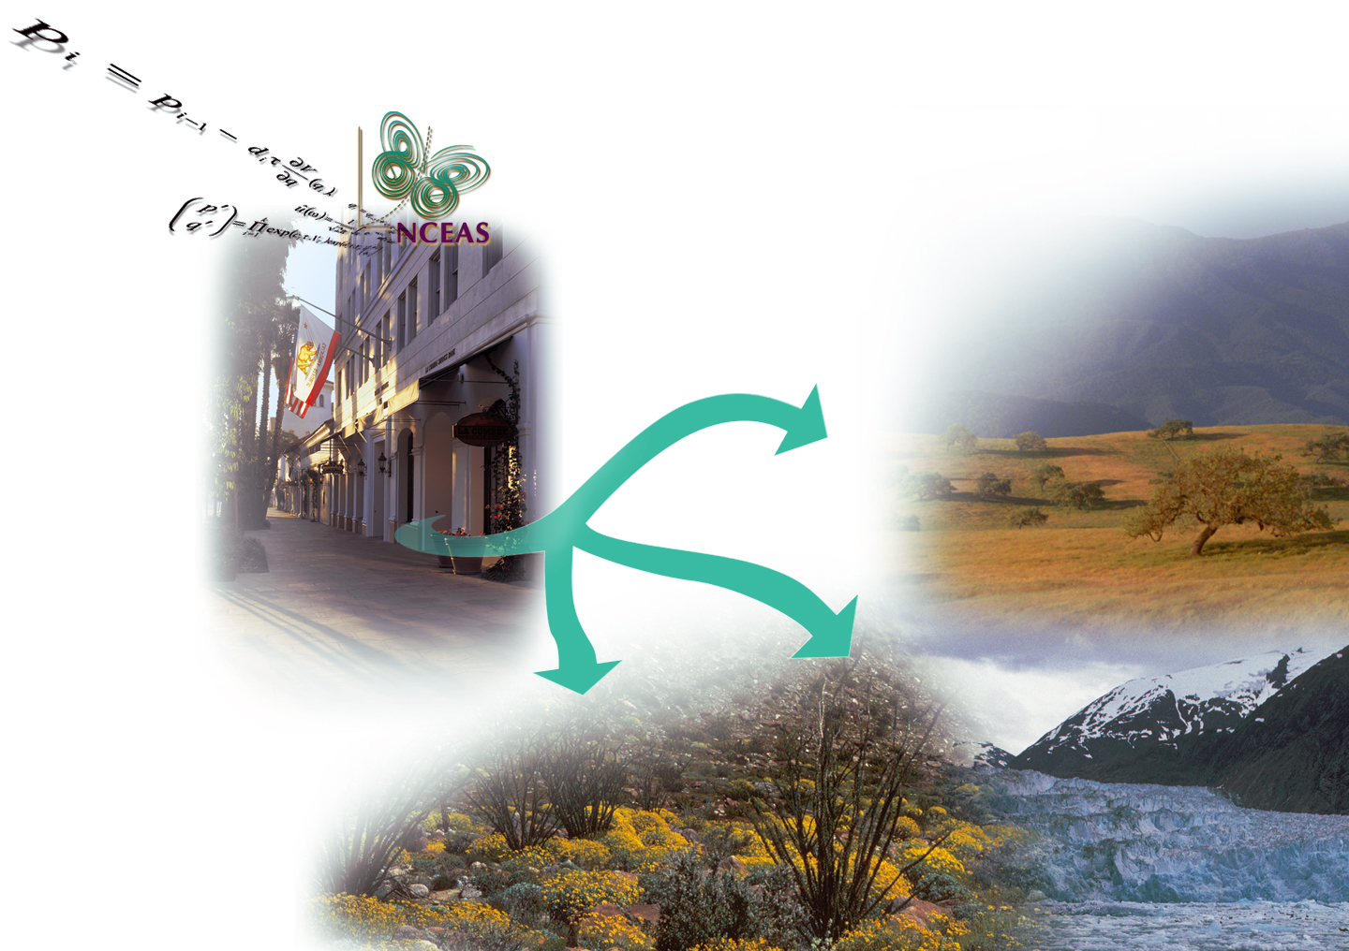
Welcome to NCEAS!

Slide 2
Logistics
Wireless password
Bathroom keys
Snacks, water, coffee & tea in lounge
Reimbursements: keep receipts!!!
$55 per diem (two drinks max/day)
International visitors: see Ginger about paperwork
Notes:
check on this for residents (Julien, Mark, Jessica, Rachel)

Slide 3
NCEAS’ History (in brief!)
founded in 1995 by the National Science Foundation, to support syntheses and analyses of existing ecological data
Working Groups and Postdoctoral Associates doing integrative ecological analyses
Highly successful:
dozens of synthesis centers modeled after NCEAS: SESYNC, CESAB, sDIV, NimBIOS...
hundreds of highly influential papers and reports
promoted culture of collaborative, interdisciplinary research
Transitioned off of NSF core-funding in 2011

Slide 4
NCEAS Today
Synthesis Science Research:
environmental, ecological, conservation, social, and earth sciences
Informatics:
cyberinfrastructure and programming support
research and development of new tools/solutions
Training:
computational and collaboration skills

Slide 5




NCEAS Today
Science for Nature and People Partnership-
SNAPP
USA’s Long Term Ecological Research
Network’s National Communications Office
NSF’s Arctic
Data Repository
Ocean Health Index
... and more...
Notes:
... and more ... Ocean Tipping Points, Gulf of Alaska, Vegbank, KNB, BIEN

Slide 6

Technical Support Services: Computing, Data, Programming/Analysis, and Collaboration

Slide 7
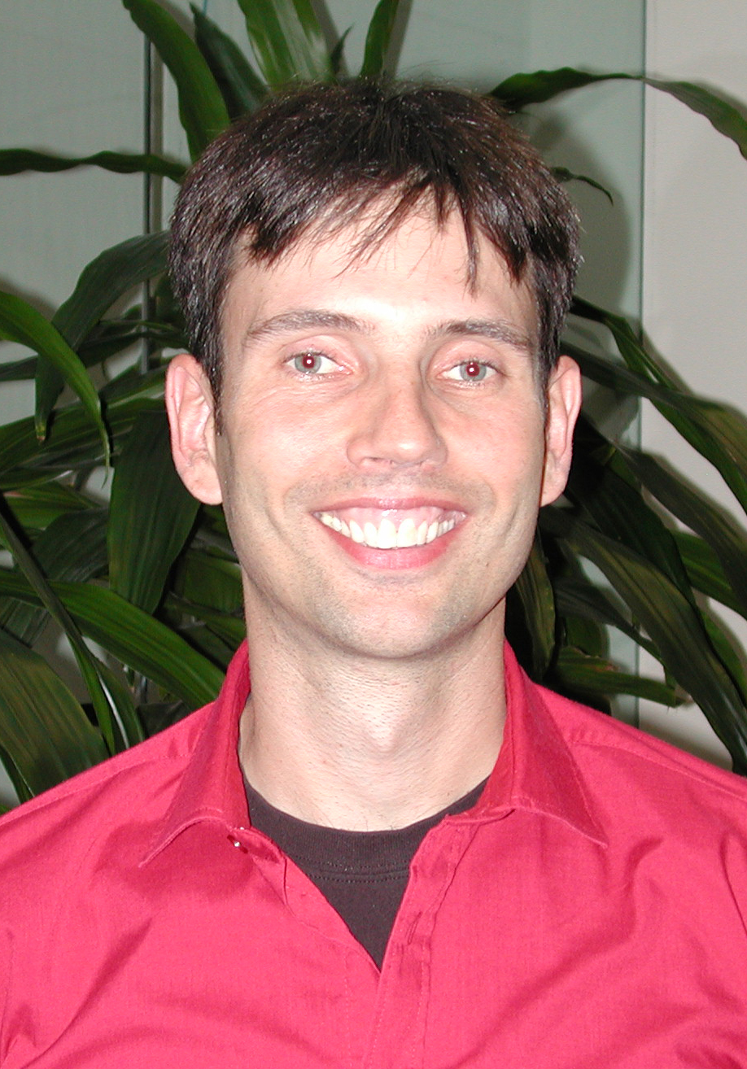
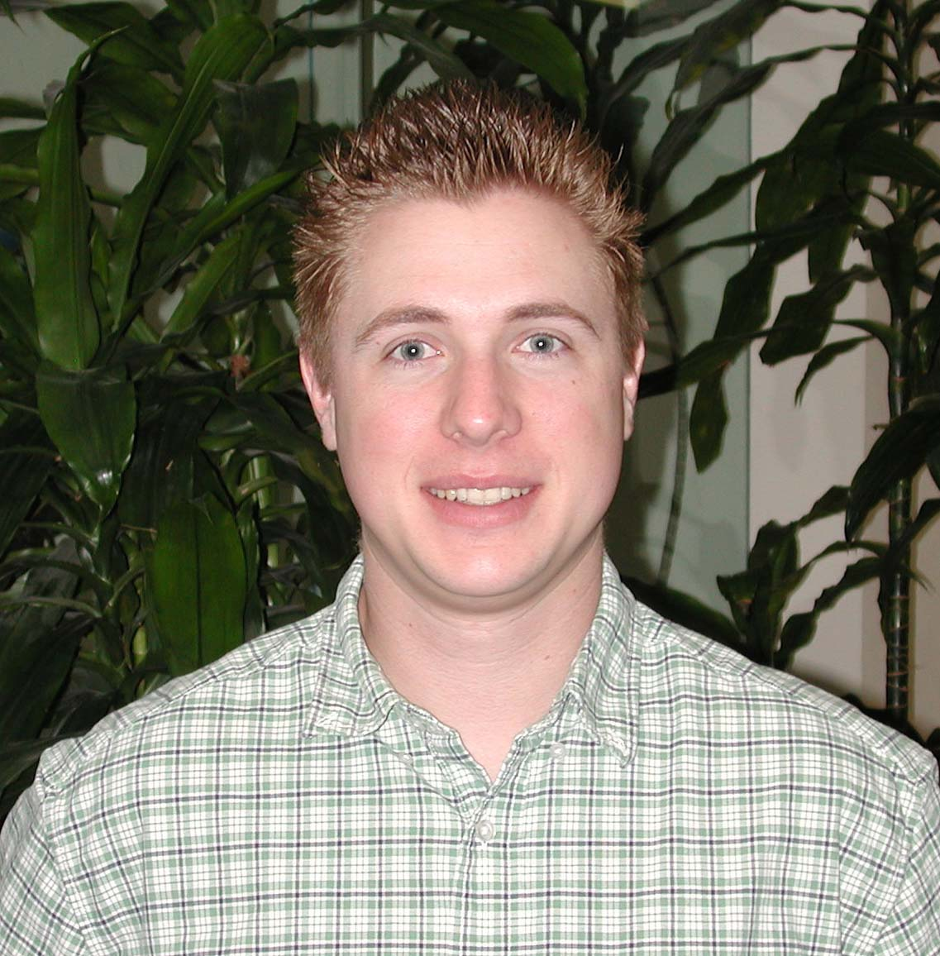
Technical Support
On-site
networking & security
printing
accounts and email lists
desktop configuration and technical advice
videoteleconferencing, remote connections
projector and large monitor use; cabling
server use, shared storage
thumb drives, dongles, etc
SELF_HELP: http://help.nceas.ucsb.edu email -- help@nceas.ucsb.edu

Slide 8
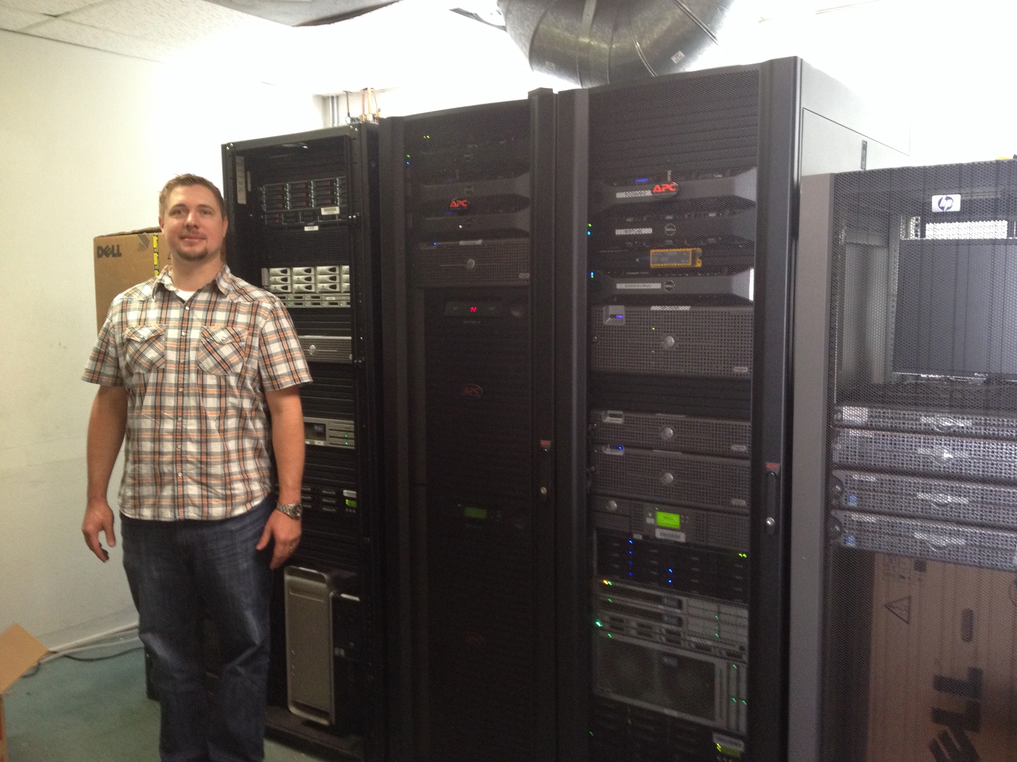
Systems Support
Linux-based servers
e.g. Aurora
20 terabytes of storage
24 Xeon CPU’s
384 GB memory
run LOTS OF models, analyses at once
execute parallelized code
R, MATLAB, Python, SAS, others
multi-user access; remote access
help@nceas.ucsb.edu

Slide 9
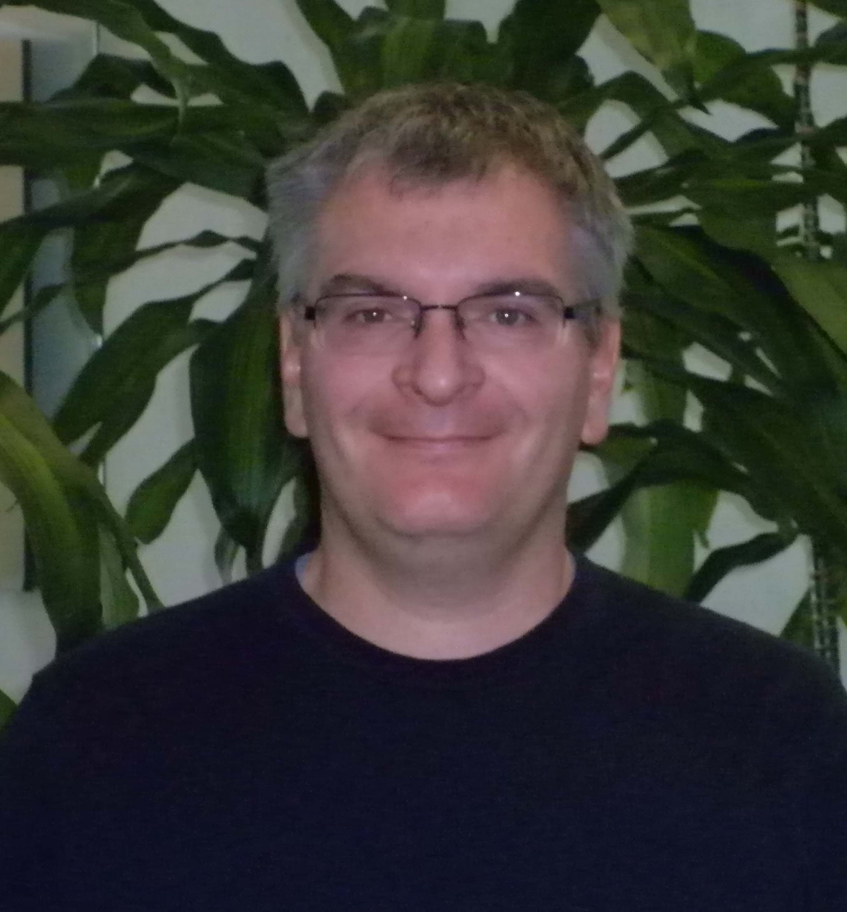
Analytical/SW Support
Programming and Analysis
Access to scientific software
Expertise in “R”, Python, others
Geospatial analysis
Shared file/document/data access
Assistance with programming
Executing codes on servers
help@nceas.ucsb.edu

Slide 10
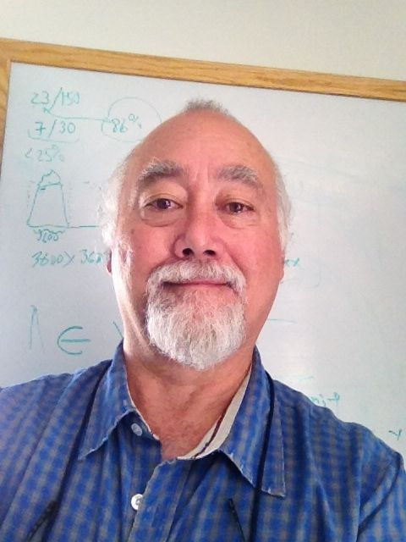
Informatics/Database Support
Storage and backups (if > 100GB, let us know)
Data modeling, and database creation
Data preservation, metadata, and archiving
Assist with data discovery/integration challenges
Shared file/document/data access
SNAPP Graduate Interns available to assist as well!
help@nceas.ucsb.edu

Slide 11
Introductions
1 minute each!
Name
Scientific interests
Analytical, computational, and informatics skills and interests
We’ll get to know each other better over the next few days

Slide 12
Introduction to SNAPP, from Executive Director, Craig Groves

